Slide 1

Palatte

Slide 2
Template Slide
- Point 1
- Point 2

Slide 3

League of Legends Game Statistic Analysis
Author: Colin Heider
Github Repo: https://github.com/cheider/LeagueofLegends-RankedGame-Analysis

Slide 4
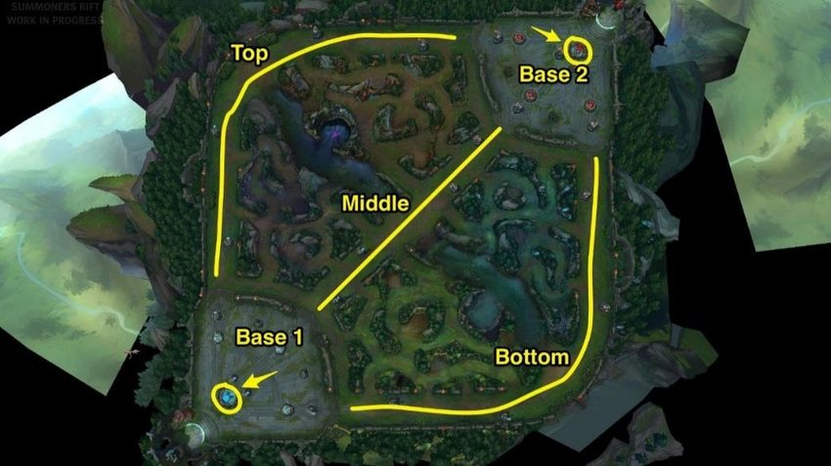
League of Legends
- Competitive team based game
- 5 players versus 5 players
- Battle Arena –> base destruction

Slide 5
Dataset
- Point 1
- Point 2

Slide 6
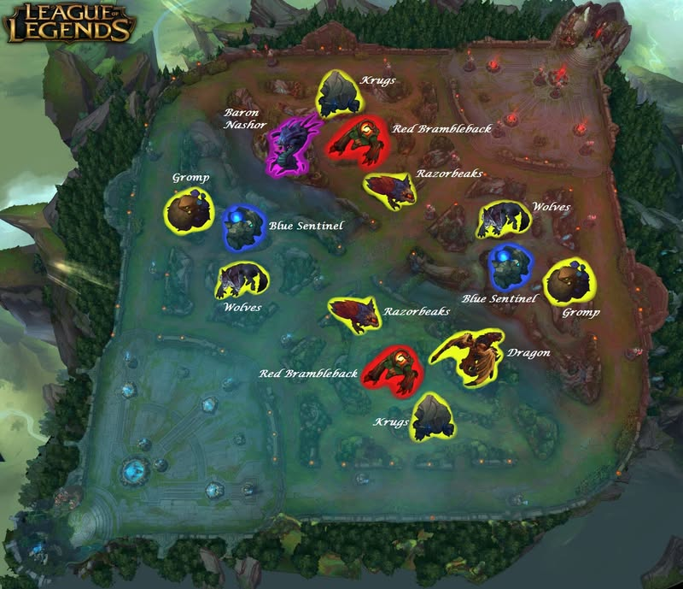
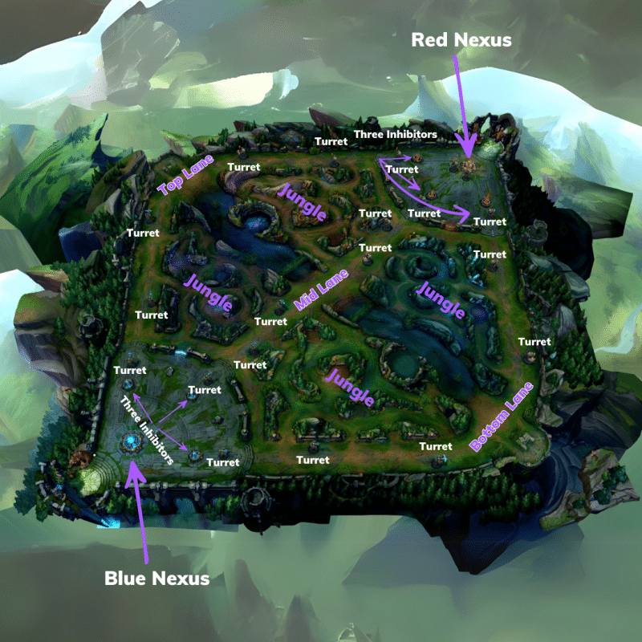
Key Points of Data
- Looking at 3 points of data and influence
- First to these objectives:
Inhibitor, Dragon, Baron

Slide 7
Thesis
- Point 1
- Point 2

Slide 8
Data Transformation
- Point 1
- Point 2

Slide 9
Count of games
- Point 1
- Point 2

Slide 10
Win / Loss
- Point 1
- Point 2

Slide 11
Analysis
- Point 1
- Point 2

Slide 12
Correlation
- Point 1
- Point 2

Slide 13
Summary
- Point 1
- Point 2

